Slide 1
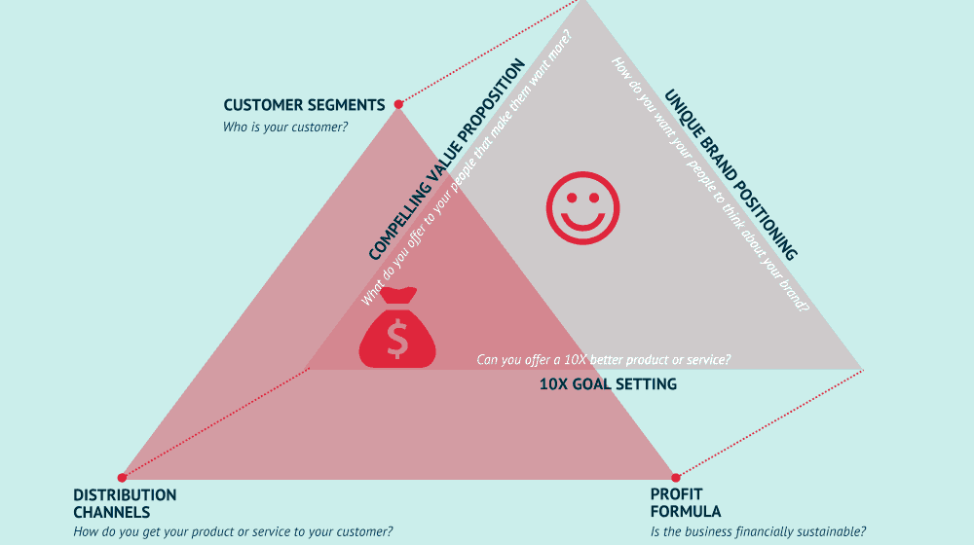

MSC3182
SOCIAL ENTREPRENEURSHIP
Lesson 4
CAPTURE YOUR BUSINESS MODEL

Slide 2
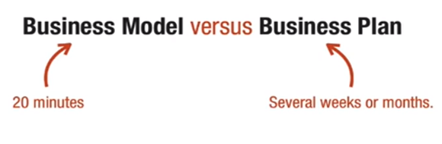
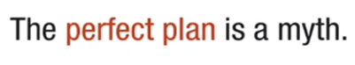
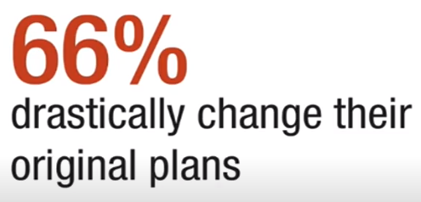

WHY BUSINESS MODEL THAN A BUSINESS PLAN
How 20 minutes for a BM, although they are complicated and critical thing to get right

Slide 3
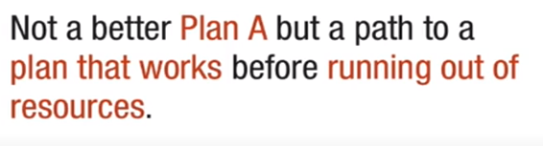
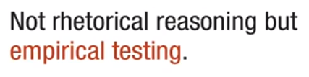
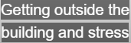
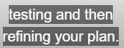
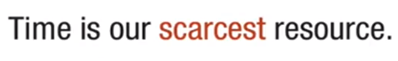
WHY BUSINESS MODEL THAN A BUSINESS PLAN

Slide 4
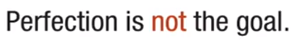
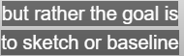
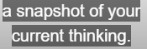
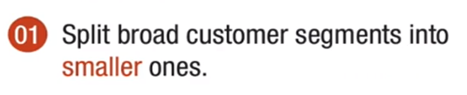
LEAN BUSINESS MODEL
FIRST STEP
DRAW YOUR CUSTOMER SEGMENT TO START THE CANVAS

Slide 5
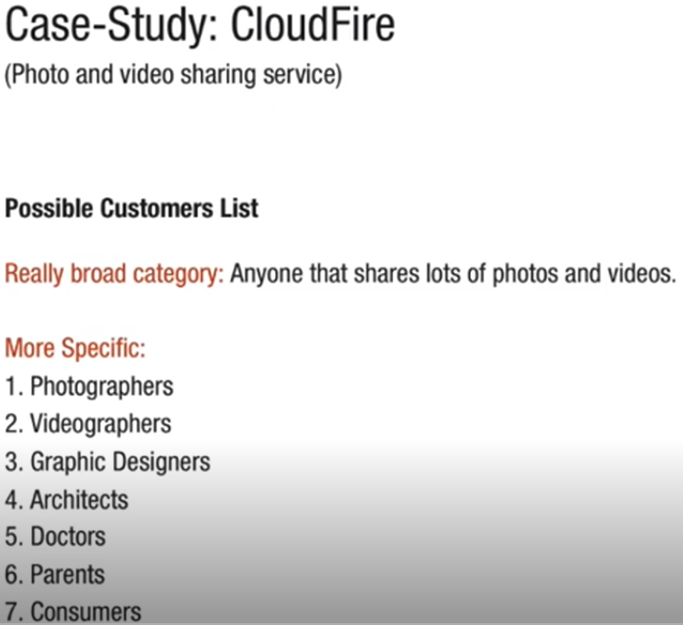
LEAN CANVAS – A STARTUP BLUE PRINT

Slide 6
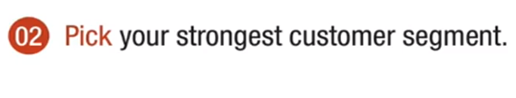
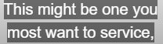
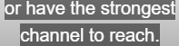
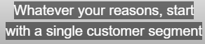
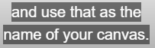
LEAN CANVAS – A STARTUP BLUE PRINT

Slide 7
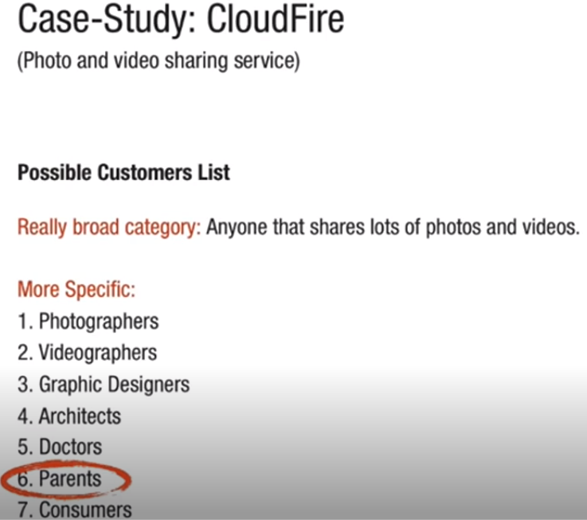
LEAN CANVAS – A STARTUP BLUE PRINT

Slide 8
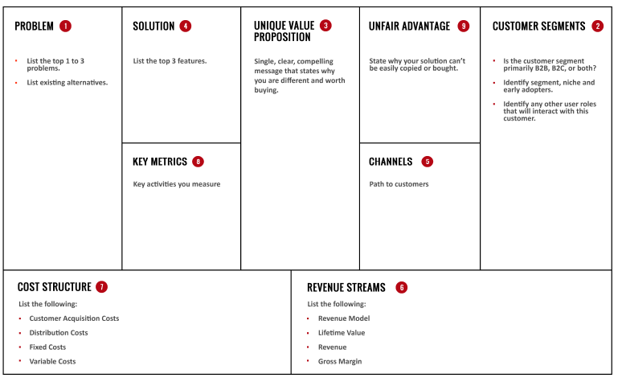
LEAN CANVAS – TEMPLATE

Slide 9
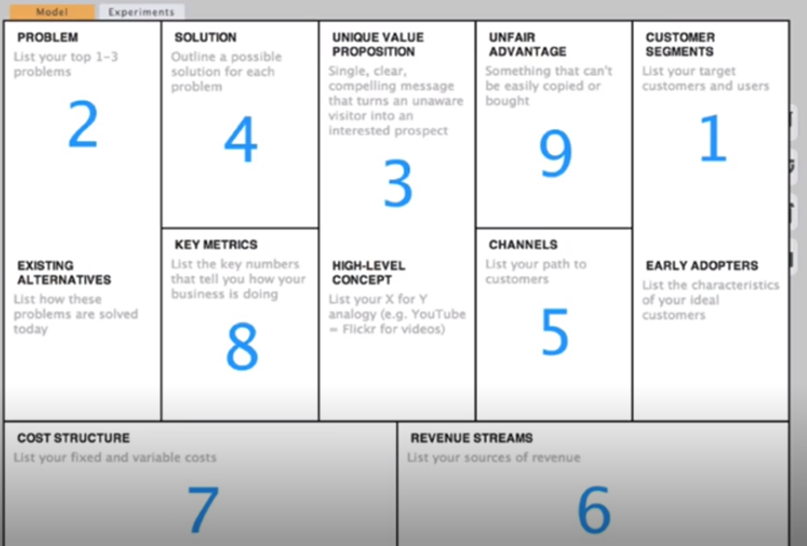
LEAN CANVAS – A STARTUP BLUE PRINT
This order is only a recommendation

Slide 10
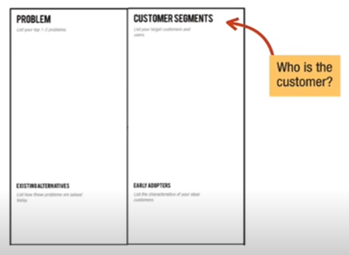
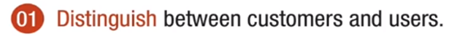
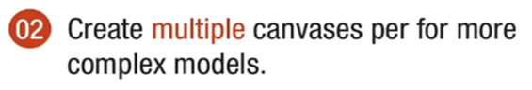
LEAN CANVAS – A STEP BY STEP PROCEDURE
A Customer pay for your product
An user doesn’t;
Try to make all you user in to potential customer

Slide 11
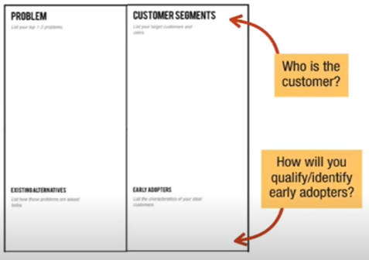

LEAN CANVAS – A STEP BY STEP PROCEDURE
Early success of the business dependent on how well you define and qualify the early adopters
E.g. – Facebook, started with the college students very specifically the students of the Harvard campus

Slide 12
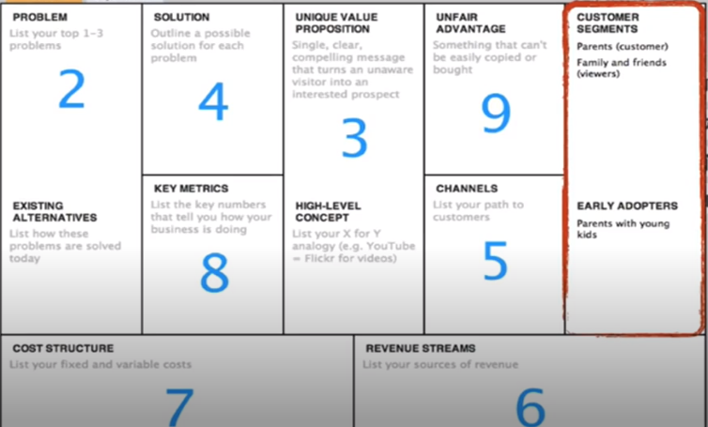
LEAN CANVAS – A STEP BY STEP PROCEDURE

Slide 13
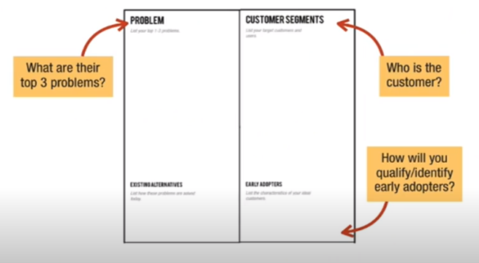
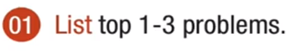

LEAN CANVAS – A STEP BY STEP PROCEDURE

Slide 14
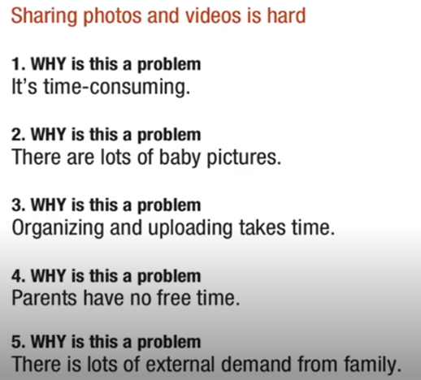
LEAN CANVAS – A STEP BY STEP PROCEDURE

Slide 15
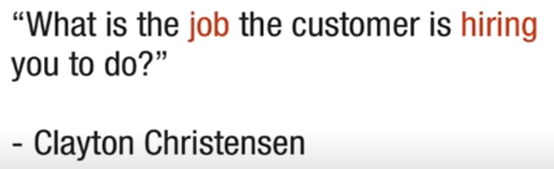
LEAN CANVAS – A STEP BY STEP PROCEDURE
Once the JTBD is identified correctly you are in a much better position to identify the underlying problem and eventually define a SOLUTION for that

Slide 16
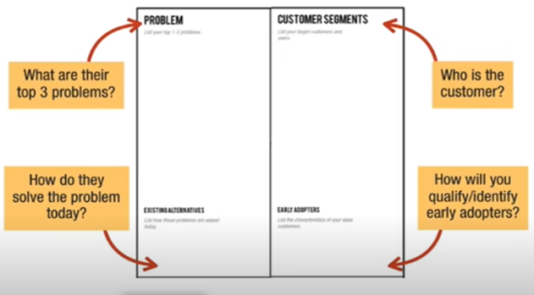

LEAN CANVAS – A STEP BY STEP PROCEDURE

Slide 17
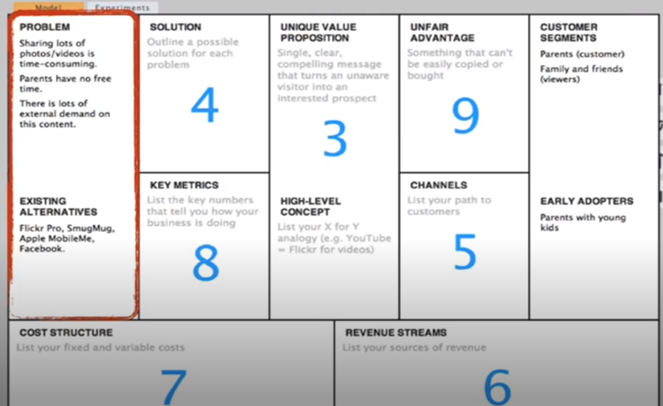
LEAN CANVAS – A STEP BY STEP PROCEDURE

Slide 18
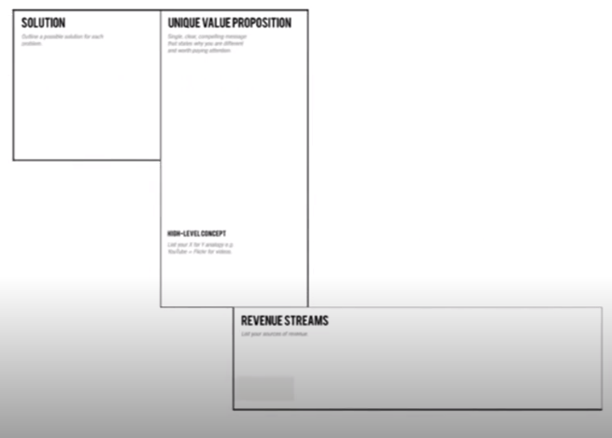
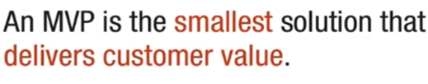
LEAN CANVAS – A STEP BY STEP PROCEDURE
Minimum viable product

Slide 19
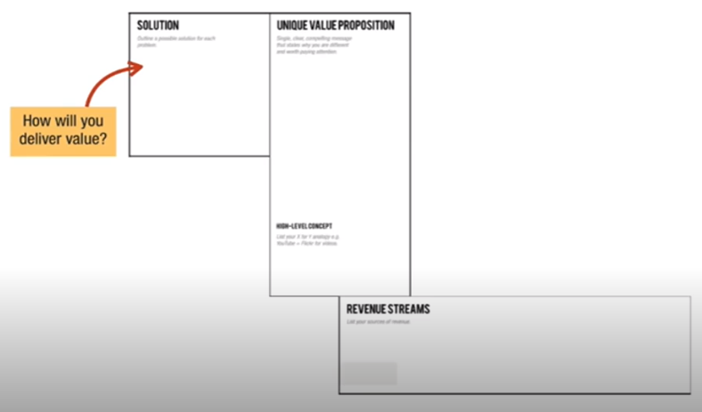
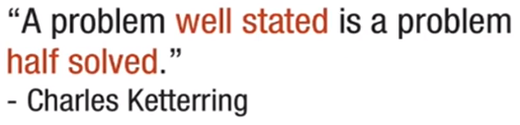
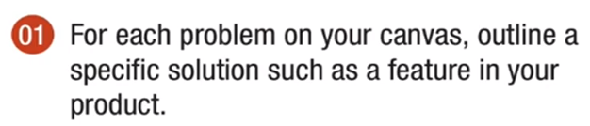
LEAN CANVAS – A STEP BY STEP PROCEDURE

Slide 20
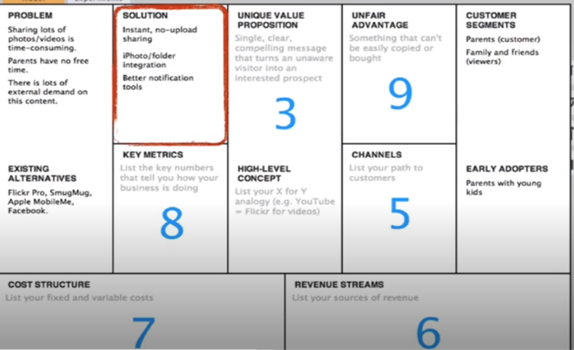
LEAN CANVAS – A STEP BY STEP PROCEDURE

Slide 21
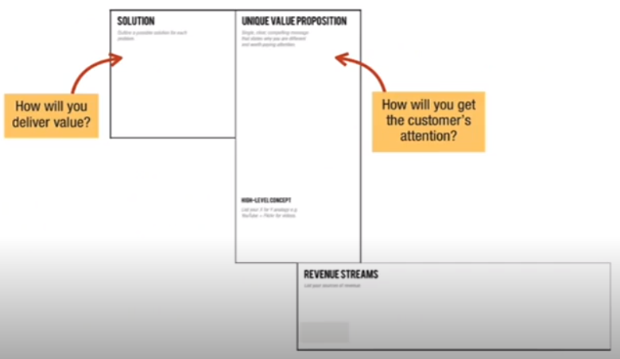
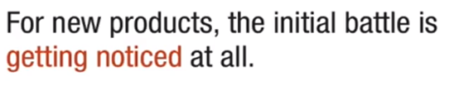
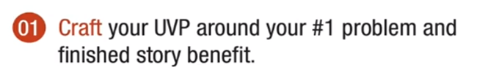
LEAN CANVAS – A STEP BY STEP PROCEDURE
Hardest thing and most critical

Slide 22
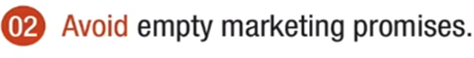


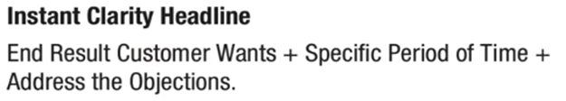
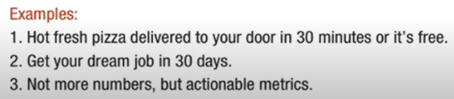
LEAN CANVAS – A STEP BY STEP PROCEDURE
Deriving Unique Value Proposition

Slide 23

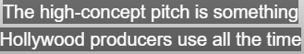
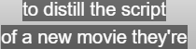
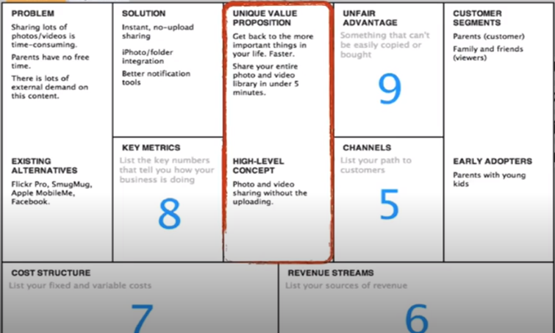

LEAN CANVAS – A STEP BY STEP PROCEDURE
Deriving Unique Value Proposition – contd…

Slide 24
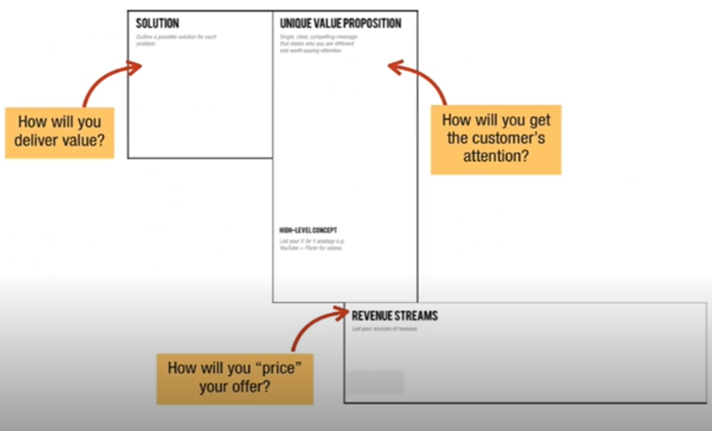
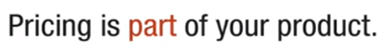
LEAN CANVAS – A STEP BY STEP PROCEDURE

Slide 25







LEAN CANVAS – A STEP BY STEP PROCEDURE

Slide 26

LEAN CANVAS – A STEP BY STEP PROCEDURE

Slide 27





LEAN CANVAS – A STEP BY STEP PROCEDURE

Slide 28



LEAN CANVAS – A STEP BY STEP PROCEDURE

Slide 29







LEAN CANVAS – A STEP BY STEP PROCEDURE

Slide 30

LEAN CANVAS – A STEP BY STEP PROCEDURE

Slide 31




LEAN CANVAS – A STEP BY STEP PROCEDURE

Slide 32

LEAN CANVAS – A STEP BY STEP PROCEDURE

Slide 33




LEAN CANVAS – A STEP BY STEP PROCEDURE
First-to-market means being the first not necessarily to launch a new product, but to gain consumer confidence and hence market share

Slide 34




LEAN CANVAS – A STEP BY STEP PROCEDURE

Slide 35

LEAN CANVAS – A STEP BY STEP PROCEDURE

Slide 36









LEAN CANVAS – AIRBNB

Slide 37

LEAN CANVAS – AIRBNB

